Slide 1
Hydroelectric Dam Operator Game
Building intuition for:
Why delays can lead to oscillation
How the order of the delay influences the oscillation

Slide 2
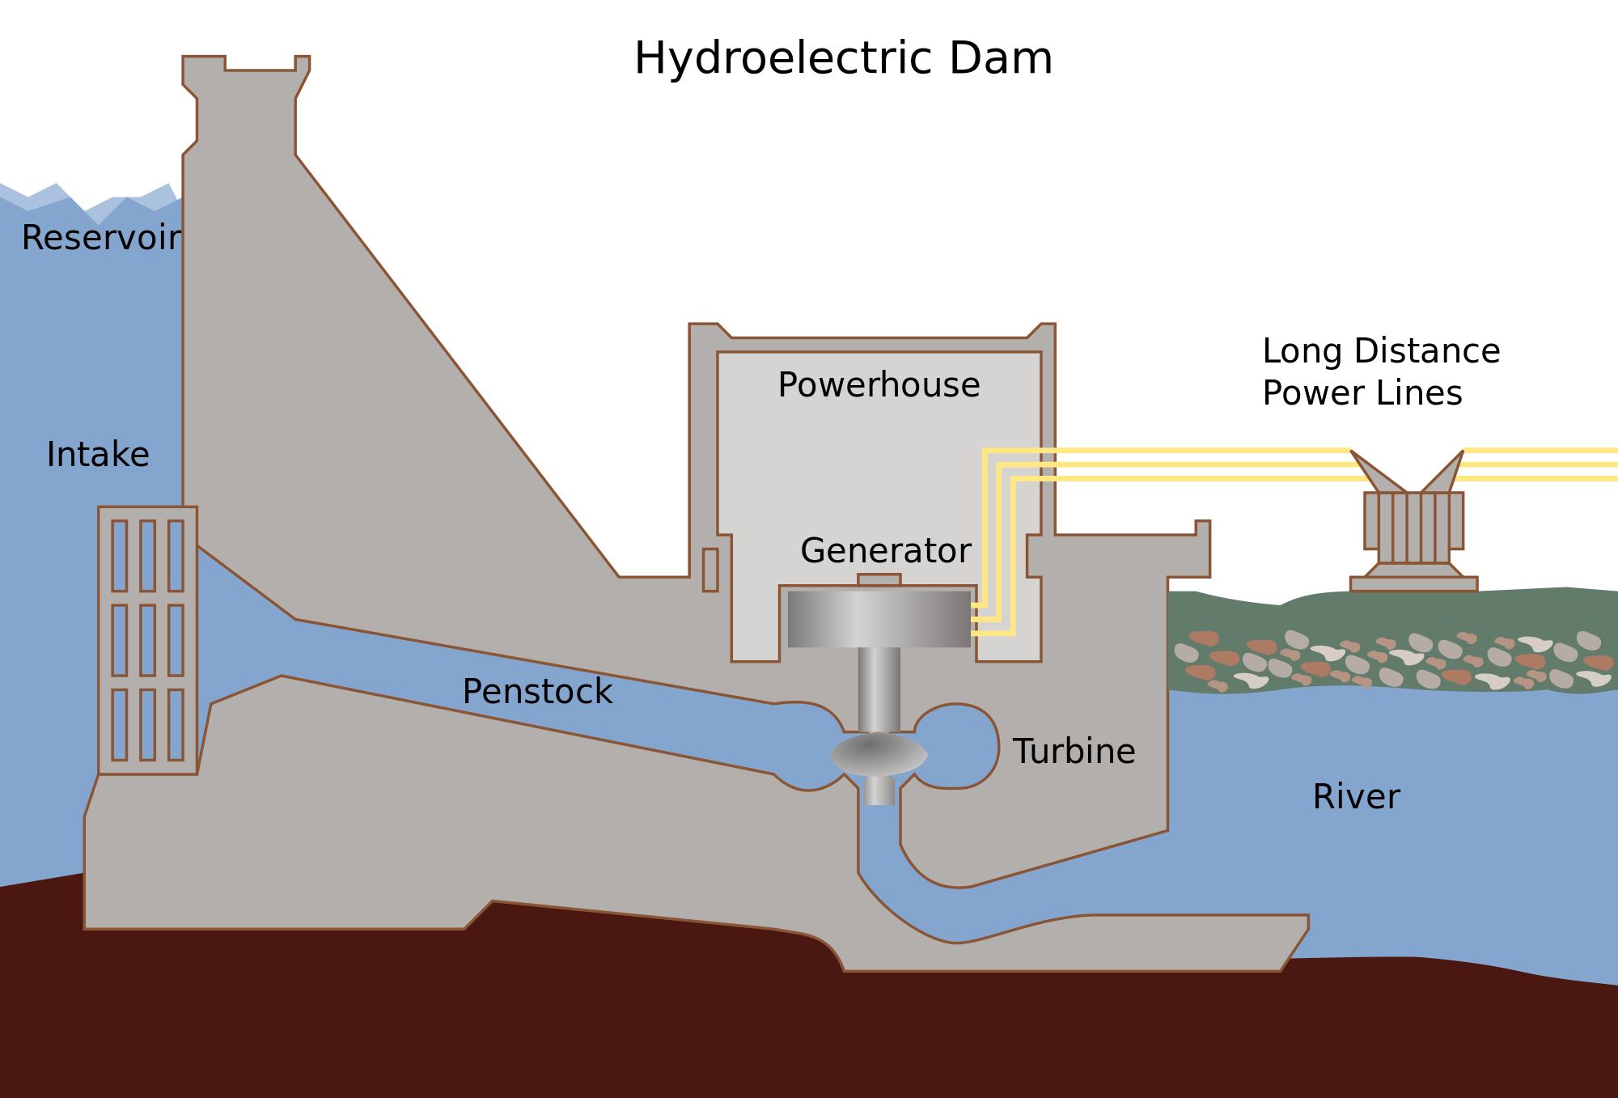
Control Point
Source: http://en.wikipedia.org/wiki/Hydroelectricity

Slide 3
Hydroelectric Dam Operator’s Challenge
Control Point
Notes:
Think about this as a first order delay – we have an intermediate stock between our control input and the output we’re trying to drive.

Slide 4
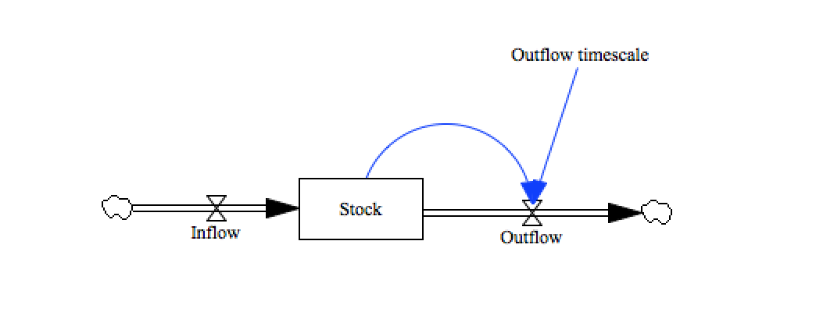
First Order Delay

Slide 5
Hydroelectric Dam Operator’s Nightmare
Control Point

Slide 6
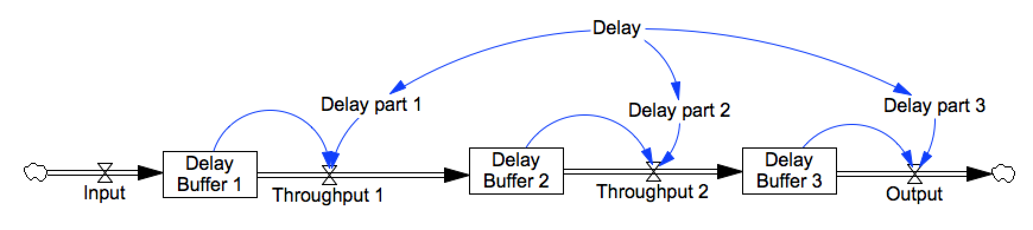
Third Order Delay

